Slide 1
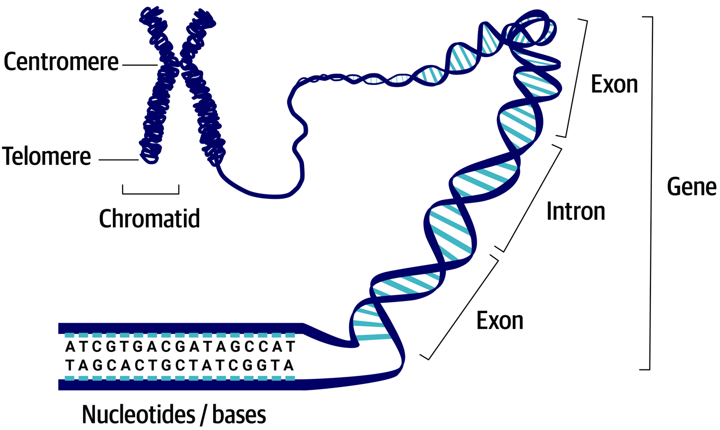
Structural Genomics
Structure of a genome has three layers
Chromosome level
How many chromosomes are there?
What is their structure?
Which gene is on which chromosome?
Epigenome
Which parts of DNA are modified/accessible?
DNA level
What is the DNA sequence of the entire genome?
How many genes are there?
Coding vs non-coding DNA elements
Genetic markers
13

Slide 2
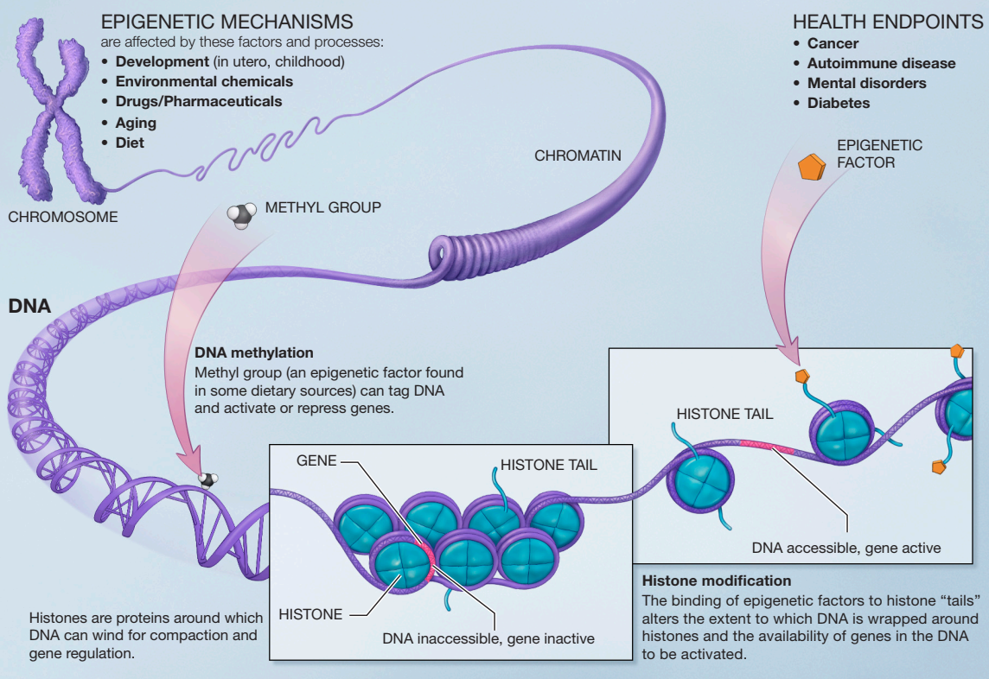
Epigenomics
Epigenetics – Chromatin state (histone modifications) and DNA methylation state
Epigenomics – Epigenetic state of a cell
Epigenetic changes effect chromatin structure -> DNA accessibility -> gene expression
Same DNA in all cells give rise to all cell types in an organism
14
Notes:
https://www.ncbi.nlm.nih.gov/pmc/articles/PMC3838898/
Comparative DNA methylation analysis to decipher common and cell type-specific patterns among multiple cell types
http://www.plantphysiol.org/content/182/1/15
Lineage-specific and single-cell chromatin accessibility charts human hematopoiesis and leukemia evolution

Slide 3
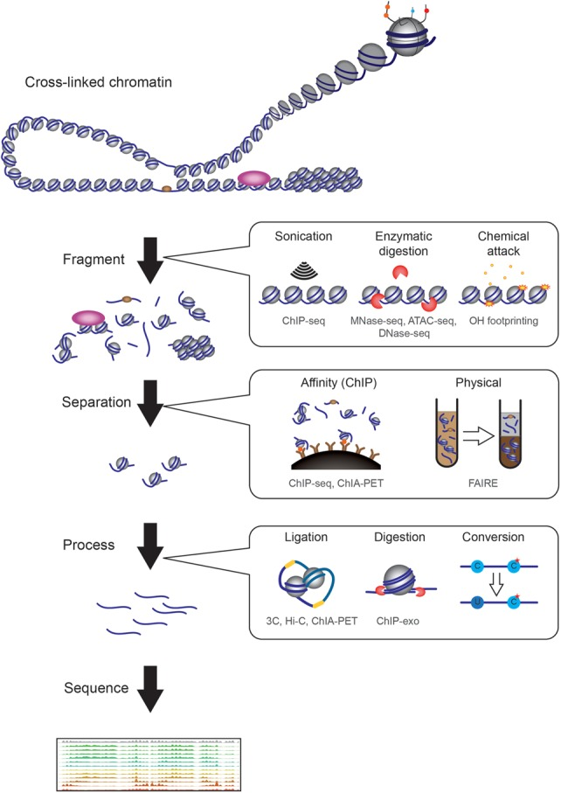
Epigenomics
How do we determine chromatin accessibility?
Enrich for a specific type of DNA, separate from rest of DNA, add adapters, sequence
15
Notes:
Epigenomics and the structure of the living genome

Slide 4
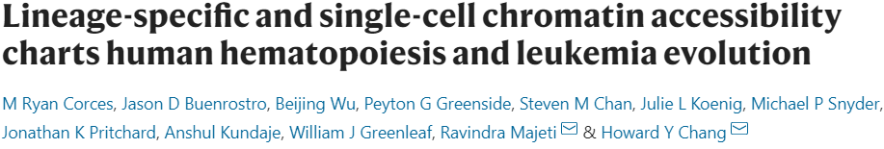

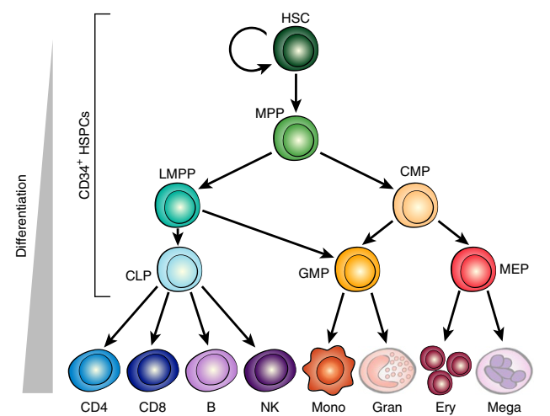
Epigenomics
How is chromatin accessibility useful? Determine cell type lineage, chart disease progress
Acute myeloid leukemia (AML)
ATAC-Seq -> Uses transposase enzyme to insert sequencing adapters into open chromatin
What do I have to understand from this paper???
Can chromatin accessibility be used to classify cell types?
How do AML pre-hematopietic stem cells resist differentiation?
16
Notes:
Paper #3: Lineage-specific and single-cell chromatin accessibility charts human hematopoiesis and leukemia evolution

Slide 5
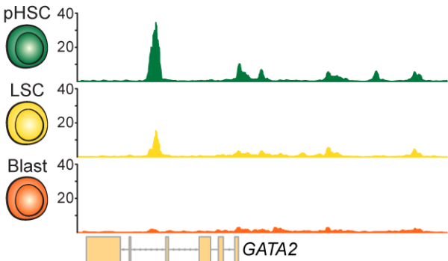
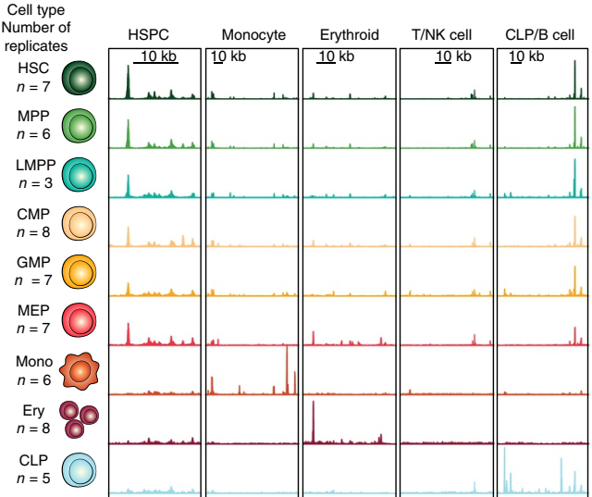
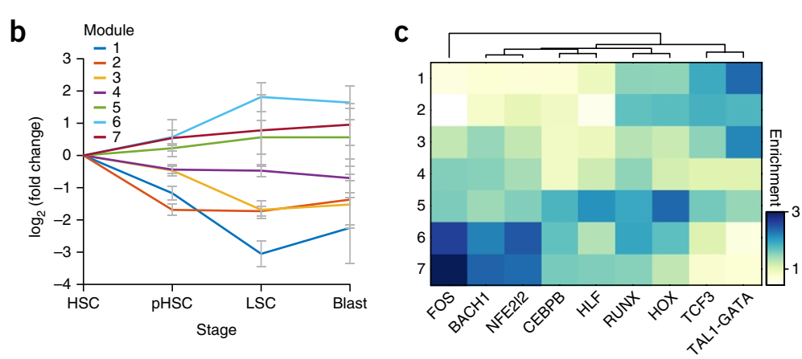
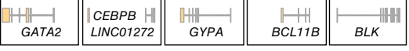
Epigenomics
How is chromatin accessibility useful? Determine cell type lineage
ATAC-Seq -> Uses transposase enzyme to insert sequencing adapters into open chromatin
17
Notes:
Paper #3: Lineage-specific and single-cell chromatin accessibility charts human hematopoiesis and leukemia evolution

Slide 6
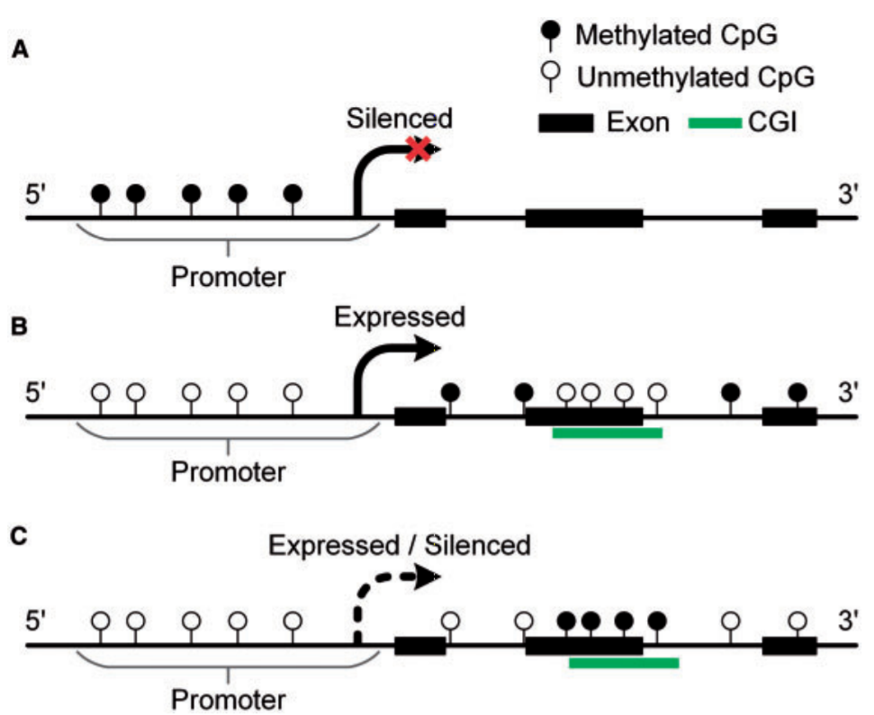
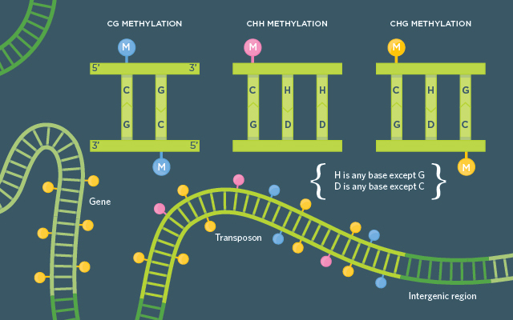
Epigenomics
Cytosines (C’s) and Adenines (A’s) can be methylated, mammals -> CpG, Plants -> CpG, CHH, CHG
Methylation can occur at promoters, exons and transposable elements
Correlates with transcriptional repression
18
Notes:
https://www.ncbi.nlm.nih.gov/pmc/articles/PMC3838898/
Comparative DNA methylation analysis to decipher common and cell type-specific patterns among multiple cell types
http://www.plantphysiol.org/content/182/1/15

Slide 7
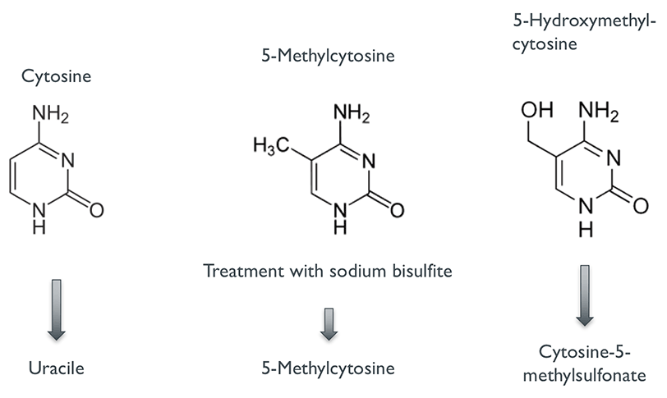
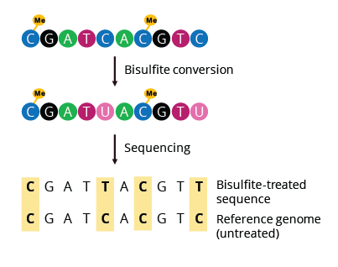
Epigenomics
How do we actually get the methylation state of a genome? Whole genome bisulfite sequencing (WGBS)
Sodium bisulfite -> C’s to U’s (eventually to T’s), can’t touch methylated C’s
Sequence treated DNA, compare to untreated reference genome
19
Notes:
https://www.ncbi.nlm.nih.gov/pmc/articles/PMC3838898/
Comparative DNA methylation analysis to decipher common and cell type-specific patterns among multiple cell types
http://www.plantphysiol.org/content/182/1/15

Slide 8
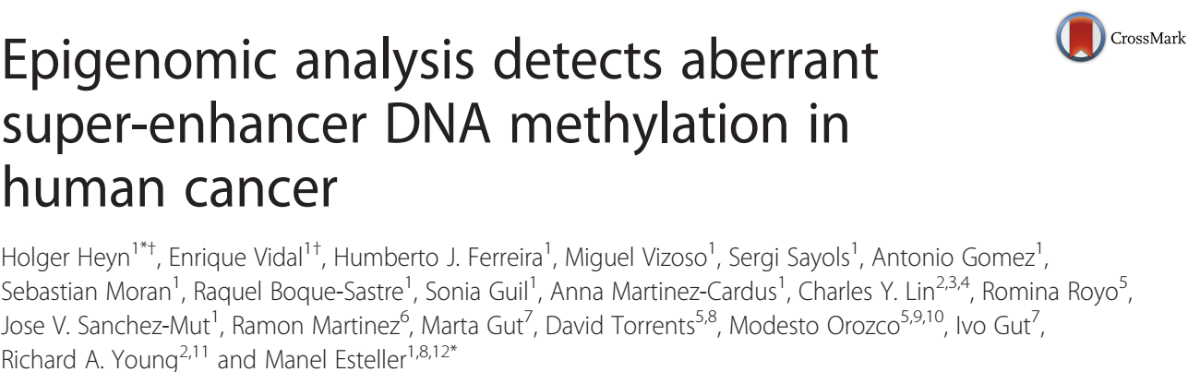
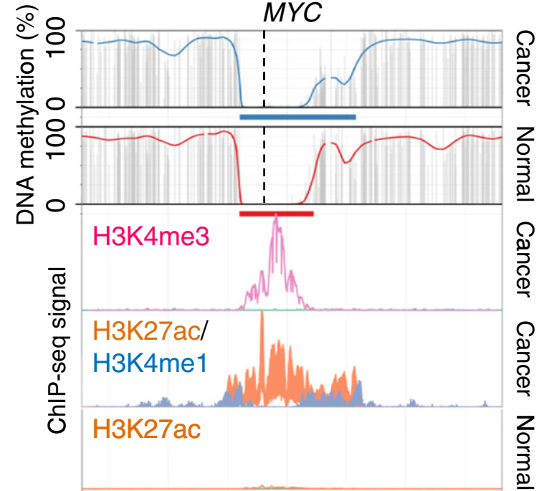
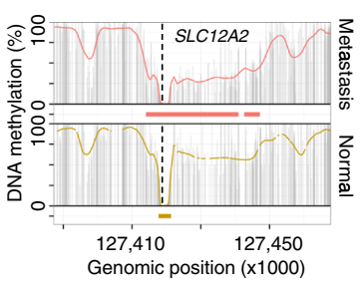
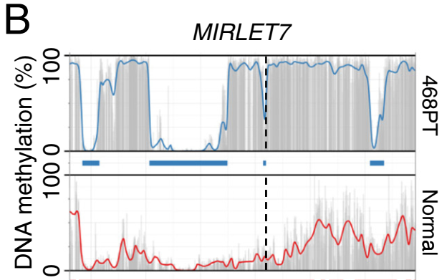
Epigenomics
Hyper or hypomethylation is implicated in many cancers -> New drug targets
Epigenetic state compared between healthy and normal tissues
20
Notes:
Epigenomic analysis detects aberrant super-enhancer DNA methylation in human cancer

Slide 9
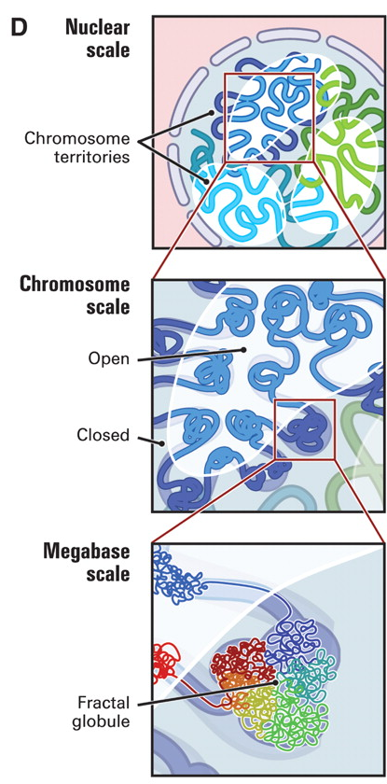
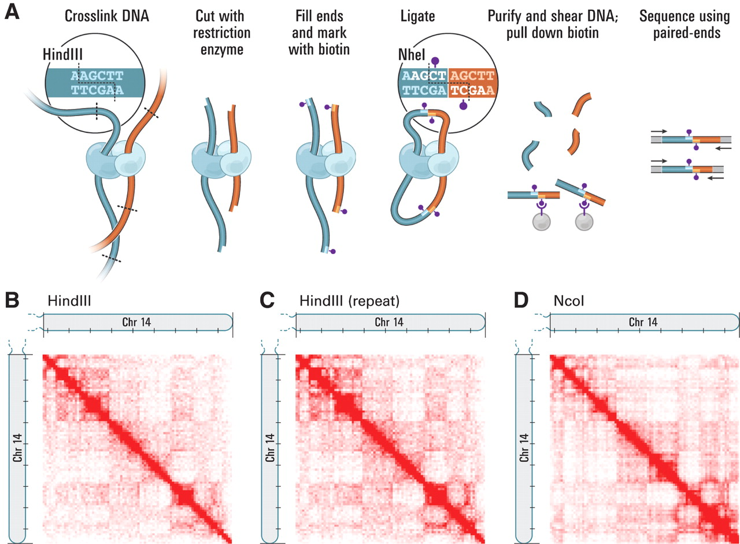
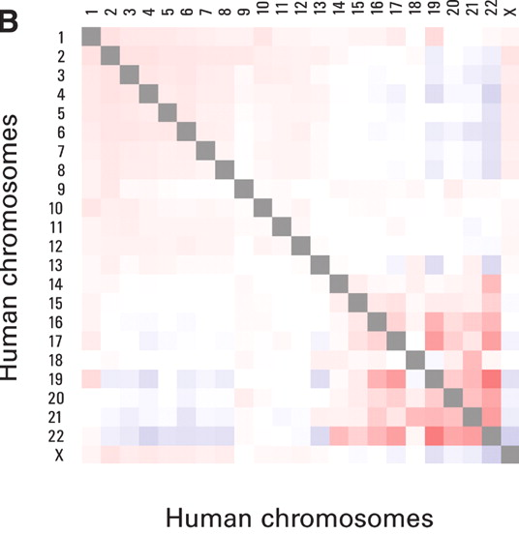
Epigenomics
Chromosome conformation capture – Looking under microscopes is hard, can we do it high-throughput style???
Interacting chromatin -> Probably closer together
21
Notes:
https://science.sciencemag.org/content/326/5950/289

Slide 10
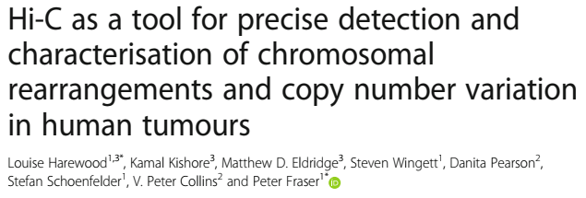
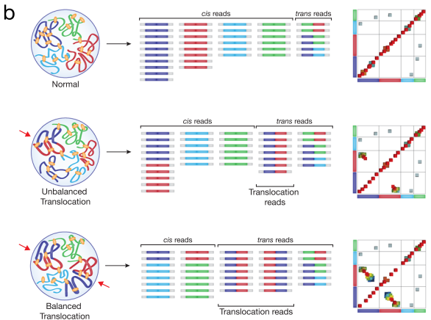
Epigenomics
What can chromosomal conformation tell us? Novel chromosome rearrangements
What do I have to understand from this paper???
What types of chromosomal rearrangements can you see on a Hi-C heatmap?
Can you differentiate a balanced vs unbalanced translocation?
22
Notes:
Paper #4: Hi-C as a tool for precise detection and characterization of chromosomal rearrangements and copy number variation in human tumours

Slide 11
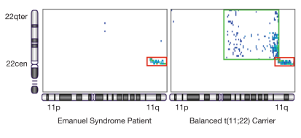
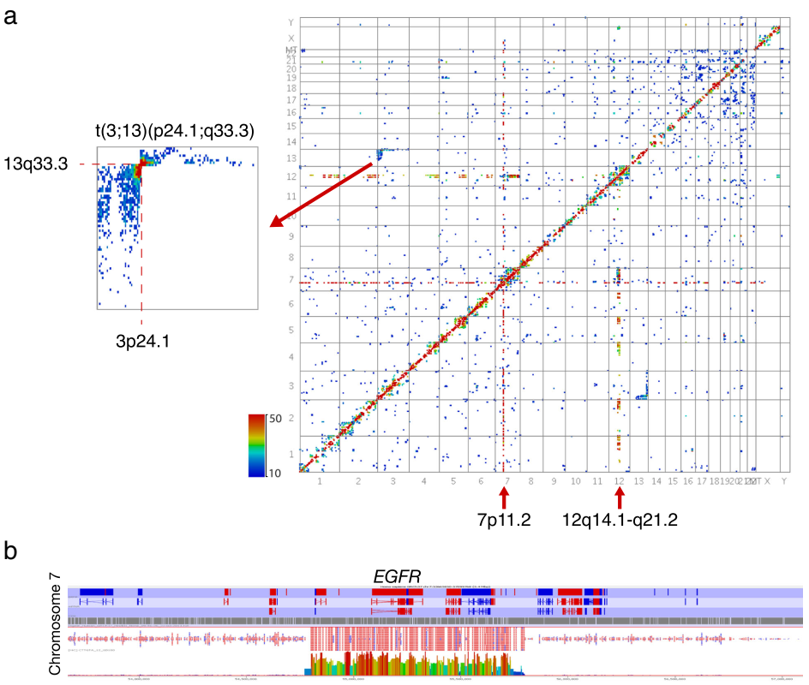
Epigenomics
What can chromosomal conformation tell us?
22
Notes:
Paper #4: Hi-C as a tool for precise detection and characterization of chromosomal rearrangements and copy number variation in human tumours

Slide 12
Short Tech break

Slide 13
Structural Genomics
Structure of a genome has three layers
Chromosome level
How many chromosomes are there?
What is their structure?
Which gene is on which chromosome?
Epigenome
Which parts of DNA are modified/accessible?
DNA level
What is the DNA sequence of the entire genome?
How many genes are there?
Coding vs non-coding DNA elements
Genetic markers
2

Slide 14
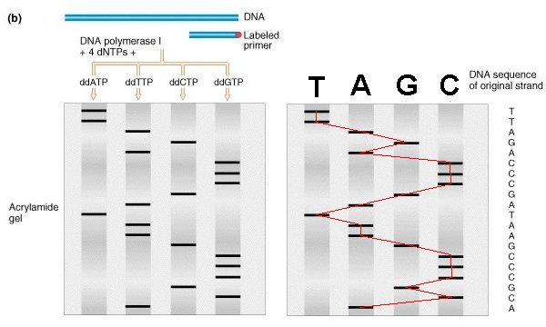
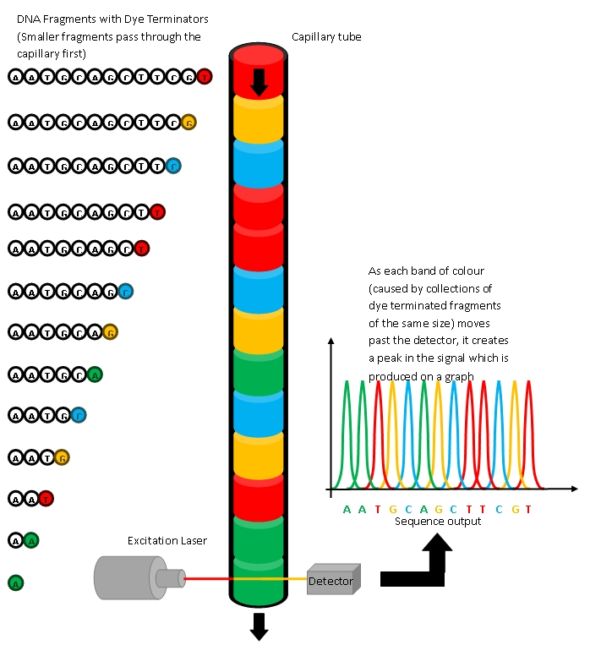
DNA Sequencing – Sanger early days
Techniques we’ve talked about so far underpinned by access to DNA sequencing on massive scale
Sanger sequencing (chain termination method) was the first widely employed techniques
Human Genome Project -> Sanger sequencing small portions of a genome integrated into yeast/bacterial artificial chromosomes (YACS/BACS)
Based on chain termination with dideoxy-nucleotides (ddNTPs), still widely used!
500-800bp per read if everything goes right
10
Notes:
https://di.uq.edu.au/community-and-alumni/sparq-ed/sparq-ed-services/sequencing-dna-using-dye-terminators

Slide 15

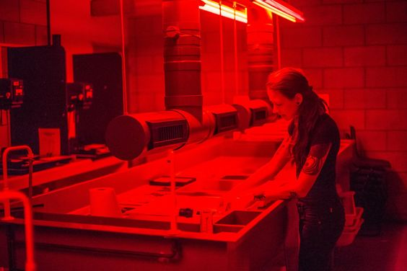
DNA Sequencing – Sanger early days
Techniques we’ve talked about so far underpinned by access to DNA sequencing on massive scale
Sanger sequencing (chain termination method) was the first widely employed techniques
Based on chain termination with dideoxy-nucleotides (ddNTPs), still widely used!
500-800bp per read if everything goes right
What’s a read? A sequence of DNA from a sequencing machine, from 5’ to 3’
Human Genome Project -> Sanger sequencing small portions of a genome integrated into yeast/bacterial artificial chromosomes (YACS/BACS)
5’
3’
5’
3’
5’
3’
3’
5’
3’
5’
4
Notes:
https://di.uq.edu.au/community-and-alumni/sparq-ed/sparq-ed-services/sequencing-dna-using-dye-terminators

Slide 16
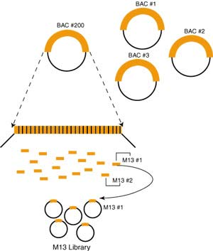
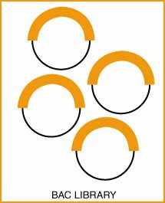
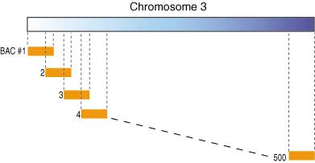
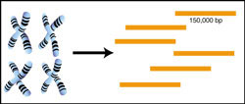
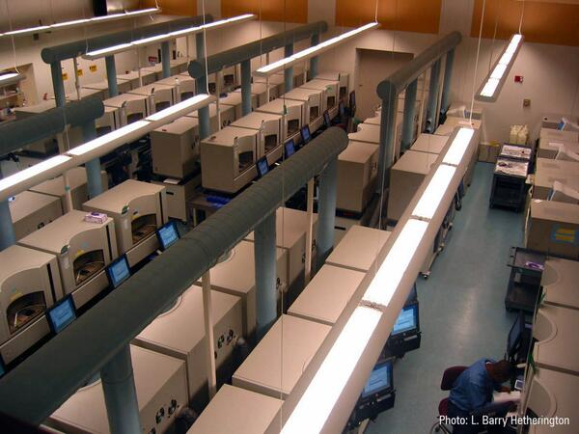
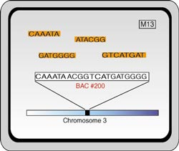
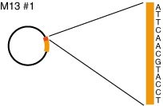
DNA Sequencing – Sanger early days
Publicly funded Human Genome Project used Sanger sequencing + BAC to BAC approach
Top -> Down, took about 10 years, 5 billion dollars, brute force!
10
Notes:
http://www.genomenewsnetwork.org/articles/06_00/sequence_primer.shtml

Slide 17
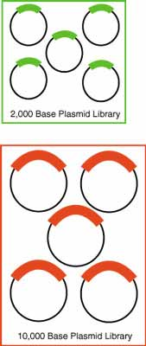
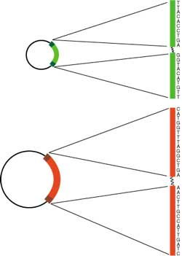
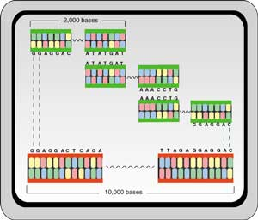
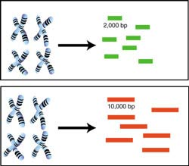
DNA Sequencing – Sanger early days
Privately funded by Celera Genomics, whole genome shotgun sequencing!
Still used Sanger sequencing, sequenced everything THEN figure out order
Bottom -> Up, took about 3 years, 300 million, hinged on clever computer algorithms for aligning DNA sequences
Paved the way for modern genome sequencing strategies
10
Notes:
http://www.genomenewsnetwork.org/articles/06_00/sequence_primer.shtml

Slide 18
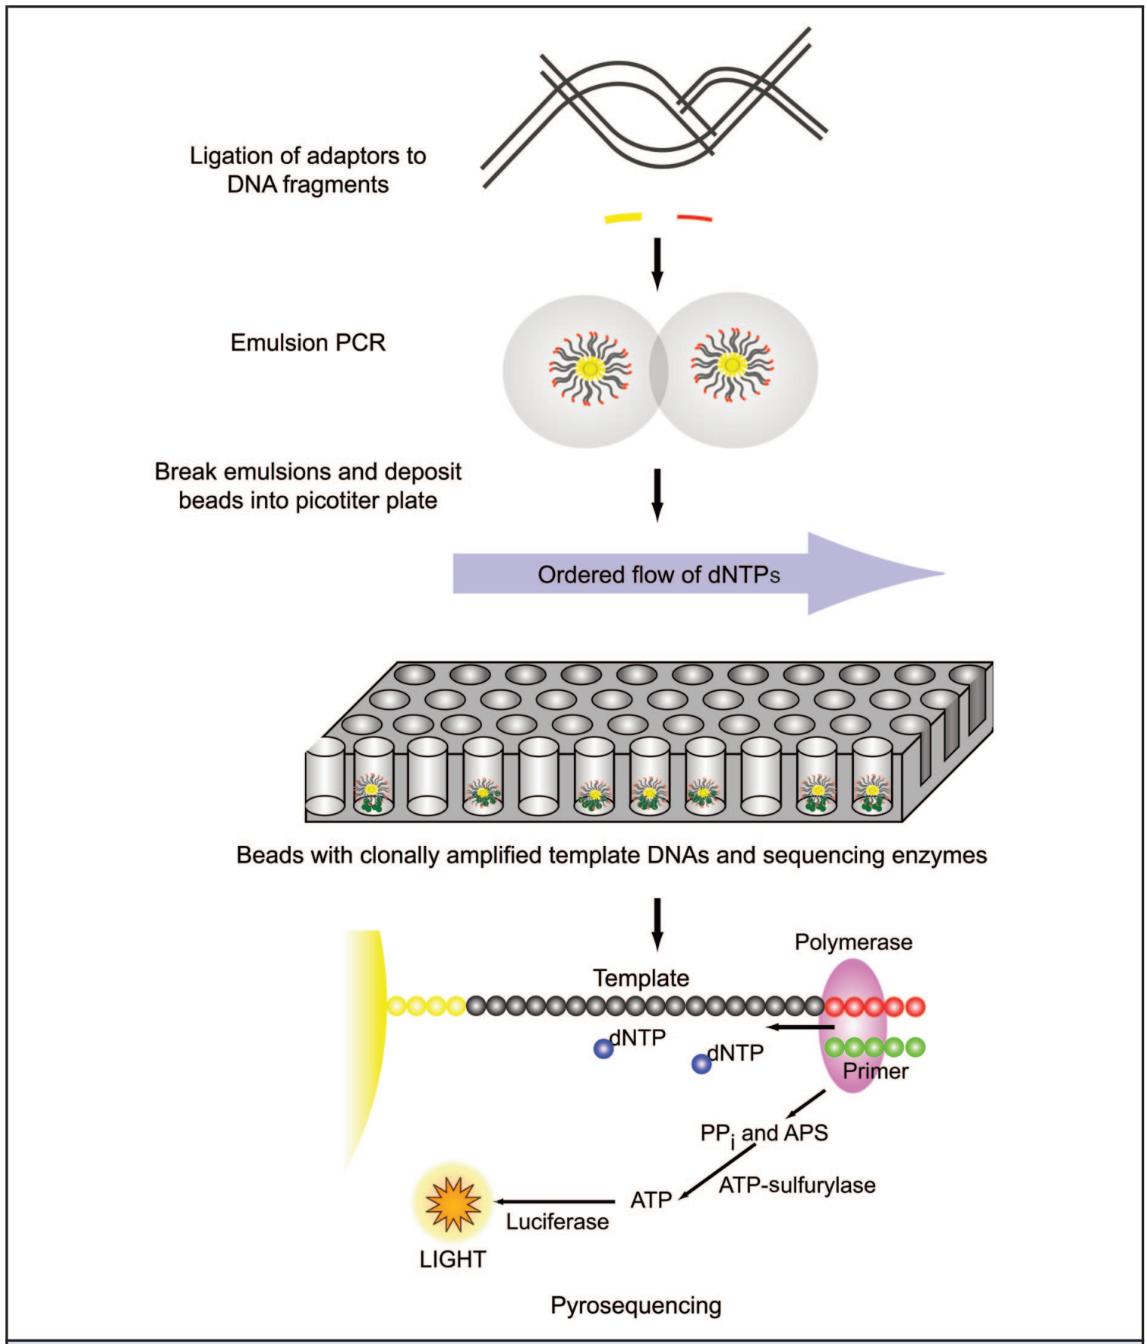
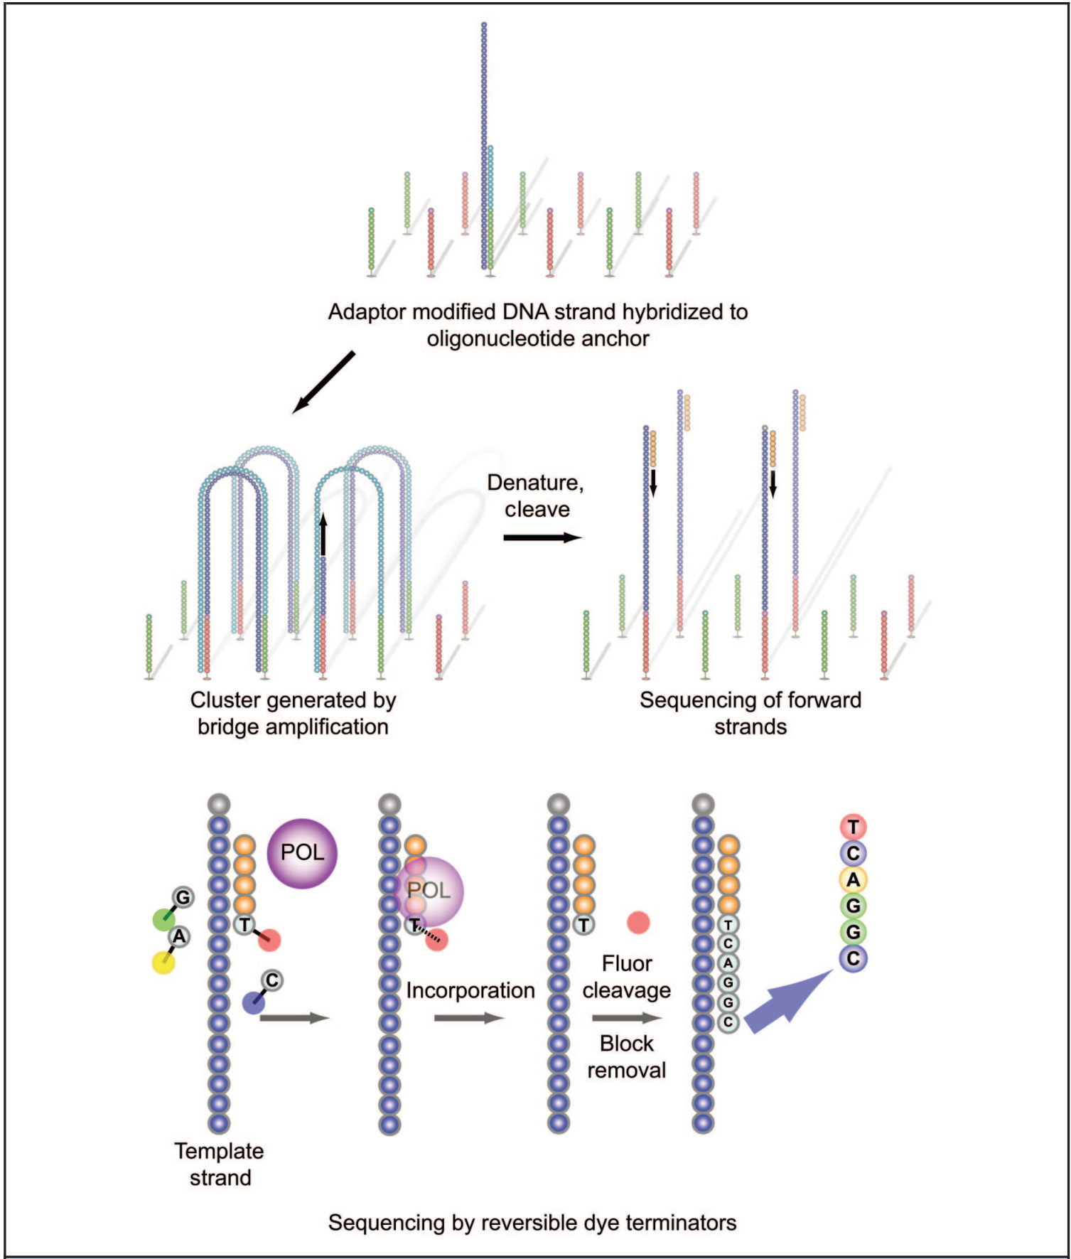
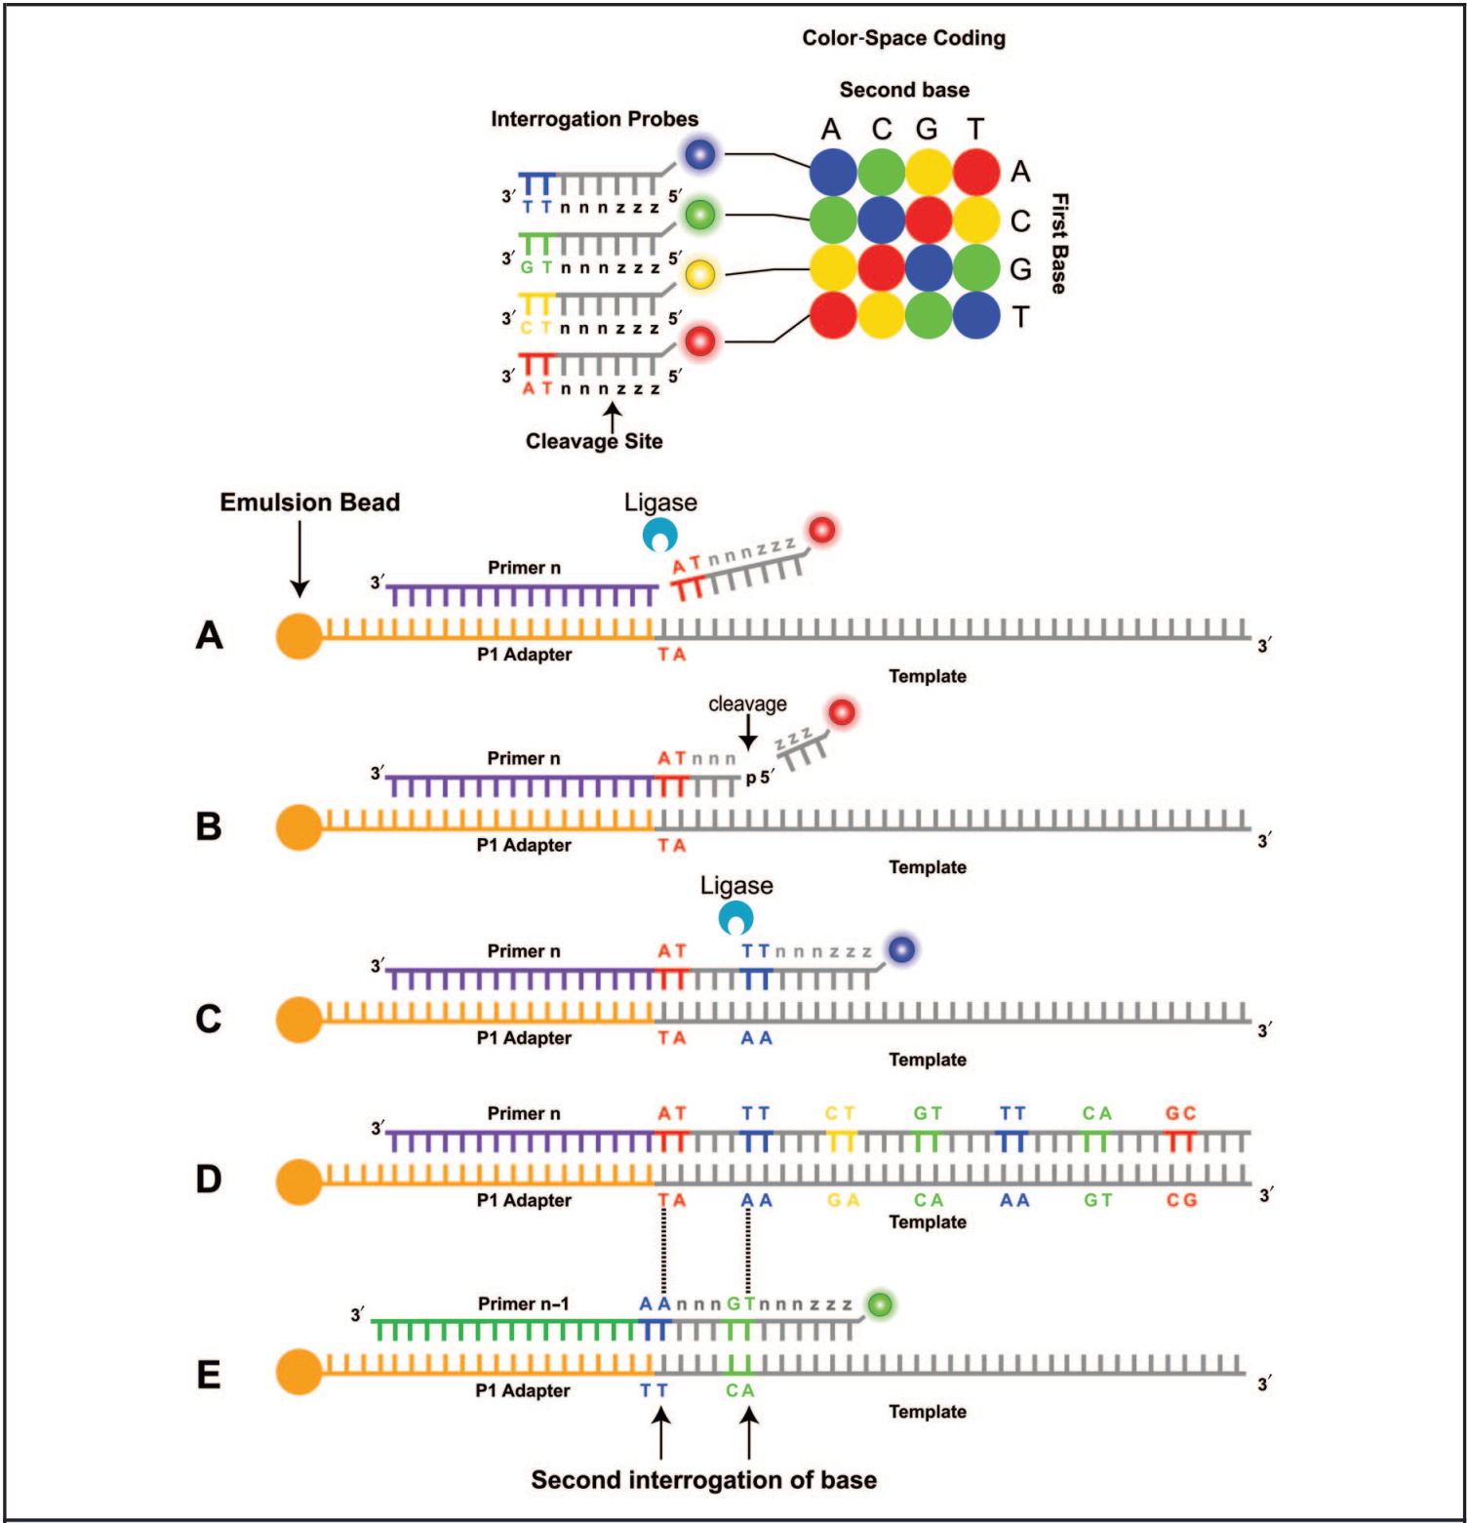
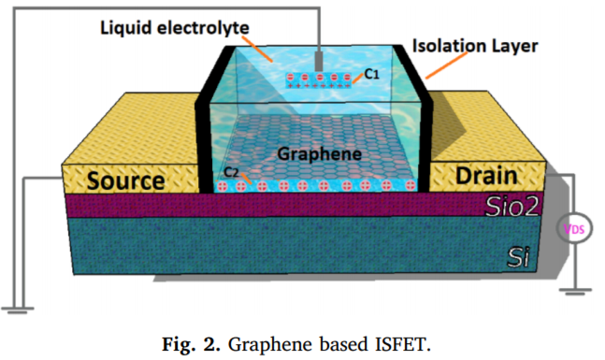
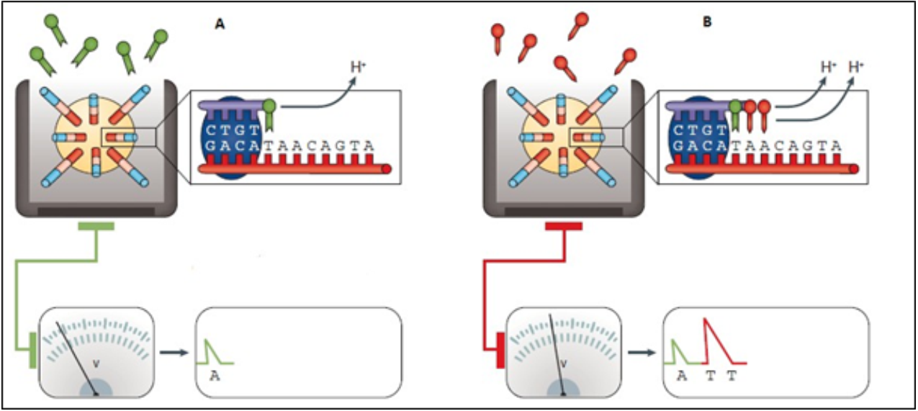
DNA Sequencing – 2nd Gen
Then came the 2nd generation sequencing platforms, 454/Roche, Illumina, SOLiD, IonTorrent
Pros and cons to each, 454 had the longest read lengths, ~400 bp(good thing), Illumina and SOLiD only did 35 bases per read
Gradually 454 and SOLiD fell out of favor
454
Illumina
SOLiD
IonTorrent
10
Notes:
Next-Generation Sequencing: From Basic Research to Diagnostics

Slide 19
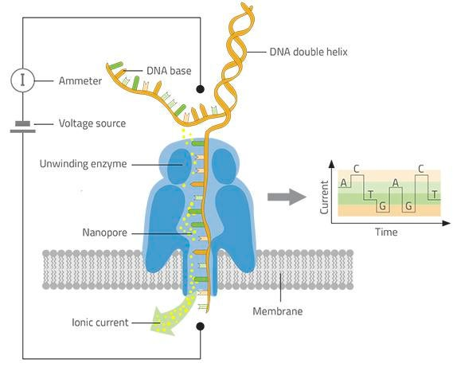
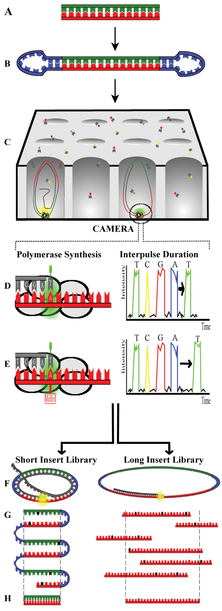
DNA Sequencing – 3rd Gen
3rd generation? (2012 to present) PacBio, Oxford Nanopore
Illumina and IonTorrent? Same-same, but different…but still same. Refined their technology, now 100-300bp reads possible
PacBio SMRT Sequencing
LONG (>20kb) average reads
Lower accuracy
Oxford Nanopore
LONG (>20kb) average reads
Lower accuracy
Very inexpensive
10
Notes:
Single molecule real-time (SMRT) sequencing comes of age: applications and utilities for medical diagnostics

Slide 20
DNA Sequencing – 2nd Gen
Then came the 2nd generation sequencing platforms, 454/Roche, Illumina, SOLiD, IonTorrent
Pros and cons to each, 454 had the longest read lengths, ~400 bp(good thing), Illumina and SOLiD only did 35 bases per read
Gradually 454 and SOLiD fell out of favor
454
Illumina
SOLiD
IonTorrent
7
Notes:
Next-Generation Sequencing: From Basic Research to Diagnostics

Slide 21
DNA Sequencing – 3rd Gen
3rd generation? (2012 to present) PacBio, Oxford Nanopore
Illumina and IonTorrent? Same-same, but different…but still same. Refined their technology, now 100-300bp reads possible
PacBio SMRT Sequencing
LONG (>20kb) average reads
Lower accuracy
Oxford Nanopore
LONG (>20kb) average reads
Lower accuracy
Very inexpensive
8
Notes:
Single molecule real-time (SMRT) sequencing comes of age: applications and utilities for medical diagnostics

Slide 22
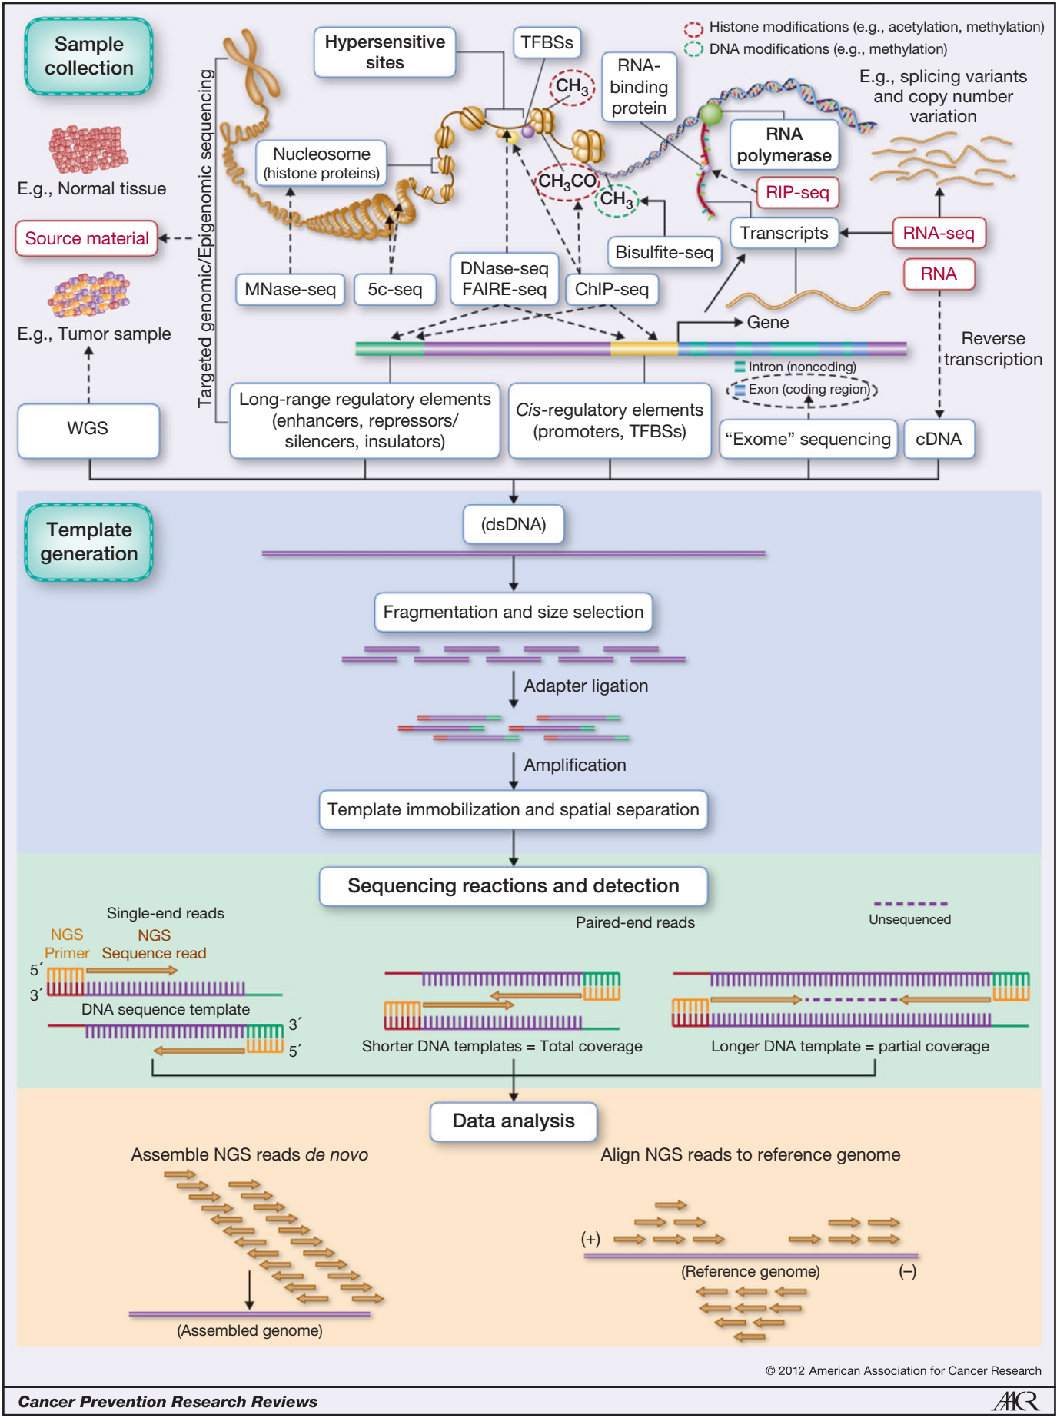

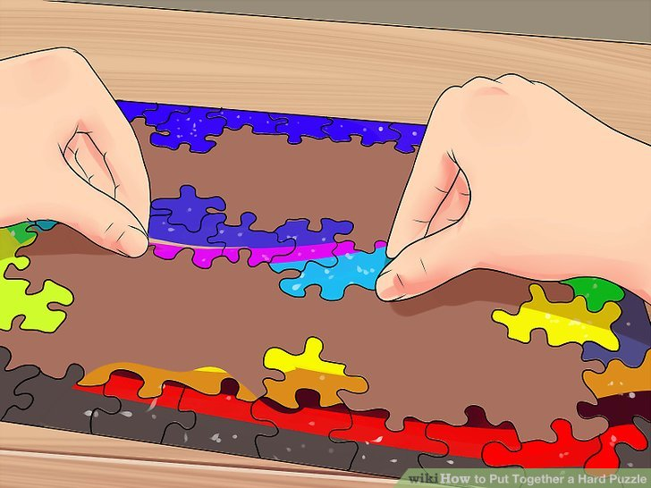
DNA Sequencing – Workflow
How would YOU, as a researcher, approach a Genomics problem?
Step 0) Define your goal
De novo sequencing? Re-sequencing?
Detecting SNPs?
Step 1) Sample Collection
Healthy/normal tissue
Replicates (Biological or technical variability)
Genomic DNA extraction, Reverse transcription, PCR
Have dsDNA? Good to go
Step 2) Sample Prep/Sequencing
Different technologies, different protocols
Size selection
Adapter ligation (Barcoding)
Amplification (PCR vs not)
Attach DNA to a chip
Throw into sequencing machine
Step 3) Assembly/Data Analysis
Quality control (Adapter trimming, quality cutoffs)
Assemble reads (de novo) or align (to reference)
Do analysis (Pre-made pipelines, custom)
9
Notes:
Key Principles and Clinical Applications of “Next-Generation” DNA Sequencing

Slide 23
DNA Sequencing – Workflow
How would YOU, as a researcher, approach a Genomics problem?
Step 0) Define your goal
De novo sequencing? Re-sequencing to fill gaps?
Scaffolding fragmented genome? Chromatin accessibility?
Step 1) Sample Collection
Healthy/normal tissue
Replicates (Biological or technical variability)
Genomic DNA extraction, Reverse transcription, PCR
Have dsDNA? Good to go
Step 2) Sample Prep/Sequencing
Different technologies, different protocols
Size selection
Adapter ligation (Barcoding)
Amplification (PCR vs not)
Attach DNA to a chip
Throw into sequencing machine
Step 3) Assembly/Data Analysis
Quality control (Adapter trimming, quality cutoffs)
Assemble reads (de novo) or align (to reference)
Do analysis (Pre-made pipelines, custom)
1
Notes:
Key Principles and Clinical Applications of “Next-Generation” DNA Sequencing

Slide 24
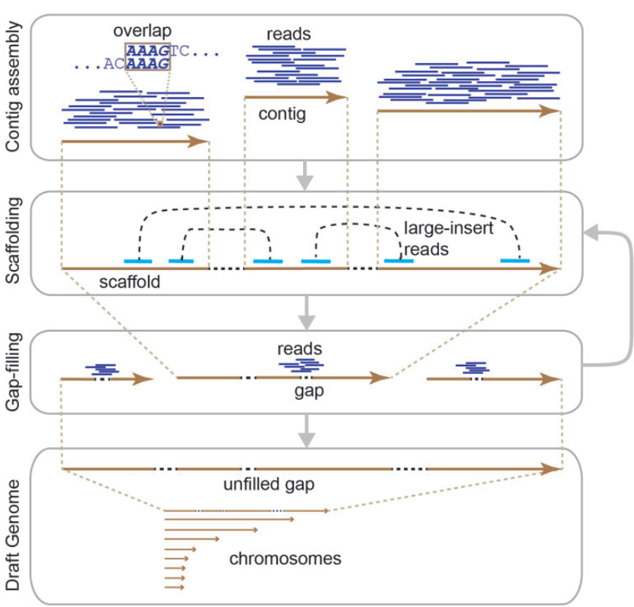
DNA Sequencing – Genome Assembly
So you download your sequencing file with 30 million reads from an unknown organism, now what?
First, you have to make “contigs” (from the work contiguous) from individual reads
2
Notes:
Key Principles and Clinical Applications of “Next-Generation” DNA Sequencing

Slide 25
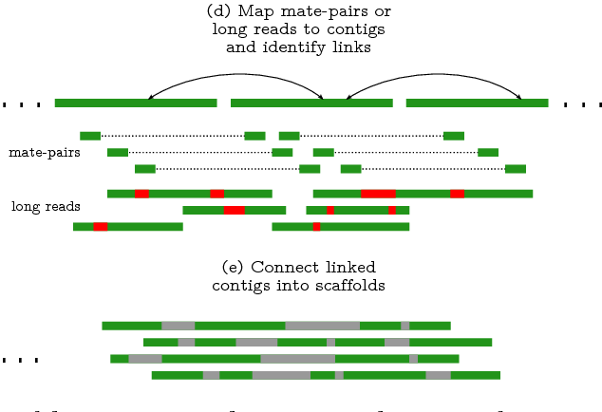
DNA Sequencing – Scaffolding
So, we have a bunch of contigs now, what next? (Some may choose to stop here!)
Need information about which contigs linked to others
Mate paired sequencing – Roughly known size of larger fragments, sequence ends…
Long reads -> Are long, high error rate (PacBio, Nanopore)
10

Slide 26
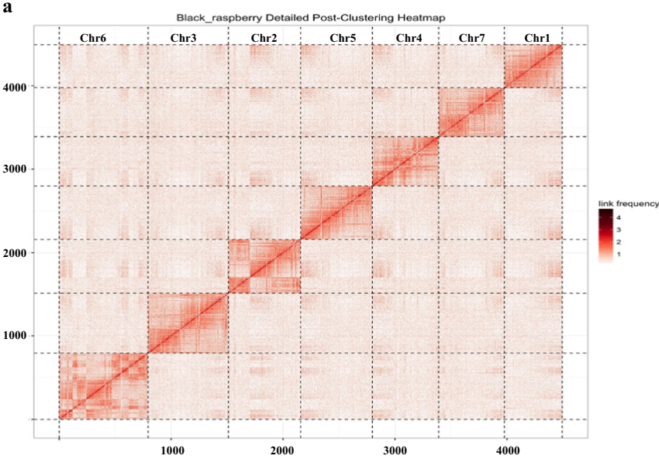

DNA Sequencing – Scaffolding
Hi-C -> not just for studying disease
We don’t have chromosome level organization, but we have contigs
Hi-C compares interactions between all loci in the genome, so contigs should interact
You can obtain pseudo-chromosomes AND location of centromeres!
10
Notes:
Chromosome-scale scaffolding of the blackraspberry (Rubus occidentalis L.) genomebased on chromatin interaction data

Slide 27




DNA Sequencing – Scaffolding
Optical mapping technology coming of age
DNA fixed on chips, stretched with microfluidics/electrophoresis
Complements DNA sequencing by providing a physical map
DNA Sequencing -> Short DNA sequences (contigs) -> Restriction sites locations within contigs
Optical Mapping -> Large DNA fragments of unknown sequence -> Restriction site location within fragments
Combined? Order contigs based on order of restriction sites
1st Gen
2nd Gen
10

Slide 28



DNA Sequencing – Scaffolding
Chromosome scale assemblies now accessible for researchers with optical mapping
Optical mapping significantly reduces number of contigs, identifies misassembles
10

Slide 29

DNA Sequencing – Scaffolding
So, we have a bunch of contigs now, what next? (Some may choose to stop here!)
Need information about which contigs linked to others
Mate paired sequencing – Roughly known size of larger fragments, sequence ends…
Long reads -> Are long, high error rate (PacBio, Nanopore)
2

Slide 30


DNA Sequencing – Scaffolding
Hi-C (Chromatin conformation capture) -> not just for studying disease
We don’t have chromosome level organization, but we have contigs
Hi-C compares interactions between all loci in the genome, so contigs should interact
You can obtain pseudo-chromosomes AND location of centromeres!
3
Notes:
Chromosome-scale scaffolding of the black raspberry (Rubus occidentalis L.) genome based on chromatin interaction data

Slide 31
DNA Sequencing – Scaffolding
Optical mapping technology coming of age
DNA fixed on chips, stretched with microfluidics/electrophoresis
Complements DNA sequencing by providing a physical map
DNA Sequencing -> Short DNA sequences (contigs) -> Restriction sites locations within contigs
Optical Mapping -> Large DNA fragments of unknown sequence -> Restriction site location within fragments
Combined? Order contigs based on order of restriction sites
1st Gen
2nd Gen
4
Notes:
Optical Genome Mapping - Joseph R. Pyle, Kurt W.E. Sy Piecco, Juvinch R. Vicente, and Jixin Chen

Slide 32


DNA Sequencing – Scaffolding
Chromosome scale assemblies now accessible for researchers with optical mapping
What do I have to understand from this paper???
How did optical sequencing improve assembly of the genome?
What types of misassembles can optical mapping detect?
5
Notes:
Paper #5: A chromosome-scale assembly of the sorghum genome using nanopore sequencing and optical mapping
BTx623 – Cultivar used In older reference genome from 2009, WGS + physical mapping techniques
Tx430 – Cultivar of sorghum used in this study

Slide 33
DNA Sequencing – Scaffolding
Chromosome scale assemblies now accessible for researchers with optical mapping
Optical mapping significantly reduces number of contigs, identifies misassembles
6
Notes:
Paper #5: A chromosome-scale assembly of the sorghum genome using nanopore sequencing and optical mapping

Slide 34

DNA Sequencing – The Endpoint
We’ve gone from reads, to contigs, to scaffolds, to chromosome level arrangements
Where does it end??? Where do you stop???
One (Old) metric – N50 – Minimum length such that 50% of the genome can be covered by contigs or scaffolds of that size or greater
Longer (Higher N50) is “better”, but doesn’t reflect accuracy of assembly
There’s also U50, UL50, UG50, UG50%, N90, NG50, and D50….
N50 of 60kb
7
Notes:
https://www.molecularecologist.com/2017/03/whats-n50/

Slide 35

DNA Sequencing – The Endpoint
Completion levels?
“Draft” genome
Usually left at contig level, minimal scaffolding
Significant errors, gaps
No chromosomal level arrangements
Good enough for some analysis
“Reference” genome
Most sequences contained within chromosome scaffolds
Few errors, gaps (Human genome has few hundred gaps)
Chromosomal level arrangement
Vertebrate Genome Project: “The consortium requires that all released genomes have an N50 size of at least 1 Mb for contigs and 10 Mb for scaffolds, that sequence error frequency be no higher than 1 in 10,000 bases, that structural variants be confirmed by multiple technologies, and that at least 90% of the sequence be assigned to chromosomes and haplotype phased.”
8

Slide 36

DNA Sequencing – Annotation
So we have the genome sequence of our organism, now what?
Annotation! What piece of DNA does what, overlapping with some aspect of functional and comparative genomics
First things first -> Repeats, repetitive regions, transposons…
45%-60% of the human genome are repeats
Centromere | The region of the chromosome at which the two sister chromatids are joined during mitosis and meiosis, mostly composed of satellite DNA.
Low complexity regions | Poly-purine or poly-pyrimidine stretches, or regions of extremely high AT or GC content.
RNA repeats | Non-functional copies of RNA genes which have been reintegrated into the genome with the assistance of a reverse transcriptase.
Satellite repeats | Multiple copies of the same base sequence on a DNA sequence. The repeated pattern can vary in length from a single base to several thousand bases long.
Simple repeats | Duplications of simple sets of DNA bases (typically 1-5bp) such as A, CA, CGG etc.
Tandem repeats | Typically found at the centromeres and telomeres of chromosomes these are duplications of more complex 100-200 base sequences.
LTRs | Long tandem repeats.
Type I Transposons/LINE | Long Interspersed Elements. Retrotransposed elements in the genome containing open reading frames encoding (often inactive) reverse transcription machinery.
Type I Transposons/SINE | Short Interspersed Elements. Retrotransposed elements less than 500 bp that contain tRNA, snRNA and rRNA, which require other mobile elements to be transposed. Alu elements are a type of SINE.
Type II Transposons | Elements that have been transposed and duplicated around the genome by excision and ligation.
10
Notes:
Comparative Genomics and Molecular Dynamics of DNA Repeats in Eukaryotes

Slide 37
DNA Sequencing – Annotation
So we have the genome sequence of our organism, now what?
Annotation! What piece of DNA does what, overlapping with some aspects of functional and comparative genomics
First things first -> Repeats, repetitive regions, transposons…
45%-60% of the human genome are repeats
1
Notes:
Comparative Genomics and Molecular Dynamics of DNA Repeats in Eukaryotes

Slide 38


DNA Sequencing – Annotation
Satellite DNA
Repetitive DNA, from 1 bp to 1 kb, i.e. ACGT ACGT ACGT x 100s
Origin? Possibly polymerase slippage
Often found in centromeres
Variable amongst individuals (high mutation rate)
Number of repeats -> DNA Fingerprinting
Transposons (44% of human genome!)
Mobile genetic elements – Autonomous or non-autonomous
Origins? Ancient retroviral infection? Gene gone rogue?
Type 1 – Genomic DNA transcribed to RNA, reverse transcribed to cDNA, inserted into genome
Type 2 – Genomic DNA excised by transposases, reinserted elsewhere
Leave behind flanking direct repeats
Repeats are recognized and masked (ATGC -> NNNN) by…RepeatMasker!
Assembled genome compared against reference database of curated repeats
Helps to reduce false matches during gene annotation
2

Slide 39


DNA Sequencing – Annotation
Next step? Gene prediction and annotation
What do we define as a gene? Protein coding region + Regulatory sequences
Many layers of data needed for a complete gene model
3

Slide 40


DNA Sequencing – Annotation
Significant differences between prokaryotic and eukaryotic gene annotation!
Prokaryotic genomes -> 80-90% coding for protein! Eukaryotes -> 1%
Eukaryotes make extensive use of INTRONS (Exon-intron-exon-intron etc) and splicing
De novo gene prediction – Looks for telltale signs of a gene
Need a start codon + stop codon in same frame, over a certain length*** (60-100 amino acids, 180-300 bp)
Other elements, Promoters, RBS, Shine-Delgarno, poly A signals…
Not very useful for eukaryotes…Dystrophin -> 79 exons!!!
4

Slide 41


DNA Sequencing – Annotation
Codon usage varies over coding and non-coding DNA
GC content also can indicate presence of gene
5

Slide 42


DNA Sequencing – Annotation
Homology modelling? Annotating genes based on previously annotated organisms
Homolog – Umbrella term, two genes are related, but how?
Paralog – Two proteins related due to gene duplication
Ortholog – Two proteins related due to speciation
Analog – Unrelated evolutionarily, but similar function
Xenolog – Related due to horizontal gene transfer
Predicted ORF is usually translated and searched against a database -> Almost always NCBI Blast
Why translated? Amino acid sequence is more conserved over evolutionary time
6

Slide 43


DNA Sequencing – Annotation
Transcriptome – RNA content of an organism at a specific moment in time/tissue/etc…
Usually interested in mRNA, sometimes small RNAs and non-coding RNAs, their levels
Extract RNA -> Reverse Transcribe to cDNA -> Make dsDNA -> Add adapters -> Sequence
Other use? Inform gene annotation! Align to your fancy new genome
Now you can look for classic splice signals (AG/G for plants), can start assigning intron/exon boundries
7

Slide 44

DNA Sequencing – Annotation
What about annotating non-coding RNA?
tRNAs – transfer RNAs – decode mRNAs
rRNAs – ribosomal RNAs – make up ribosomes, are actually ribozymes!
Subunit sizes defined by Svedberg units (i.e. 60S large sub-unit, 40S small subunit)
Small RNAs – Less than 30 bp – Secondary structure often involved in generation
miRNAs – micro RNAs – knock down expression of a gene
siRNAs – small interfering RNAs - knock down expression of a gene
piRNAs – Piwi-interacting RNAs – supress transposons
snoRNAs – small nucleolar RNAs -
lncRNAs – Long non-coding RNAs >200 bp
Low abundance vs mRNAs
Can have scaffolding functions, decoy functions
Or…can truly have no function
Small RNAs/lncRNAs are difficult to detect, usually need to enrich for specific RNAs (How?)
Transcription in an area, but no protein? Something biological could be happening!
8

Slide 45
Module Summary
Structural Genomics
Chromosomes
Epigenome
Genomic DNA
Size
Shape
Number
Physical Map
Accessibility
Methylation
Conformation
Sequencing
Assembly
Annotation
Gene models
9

